Slide 1







Data Quality and Validation Implementation @ Largest Bank in the MENA region
Business Drivers
Key Highlights
The merger of two large banks of Middle East has created the biggest bank in the region with approx. $183 bn of assets, representing 27% share of the UAE Banking sector. As a result of the merger, the organization has decided to integrate its various business units of both entities and its underlying technology platform
Enable one bank customer experience through integration of IT applications and infrastructure
Business rule based Data Quality assessment for cross application data entities
Solution Highlights
Approach recommendation for automated or manual data cleansing process
Rule based data profiling for cross application data entities like loans, trades and payments.
Defined data migration approach for cards and loans applications to establish linkage between onboarding application, core banking and 3rd party product processors
Recommendation on solution approach for data cleansing using automated rules, manual cleansing or bulk upload of manually cleaned data
Defined operating model for data cleansing throughout various migration runs and pre-post integration
Development of automated data cleansing and data migration rules using SSIS (ETL tool)
Perform Data Validation and generate reconciliation reports during various data migration rehearsals
Automated data validation using Cognizant's proprietary tool to reduce migration sequence timing
Technology Stack: OEDQ, SSIS, PLATINUM
Early detection of data migration specs and mapping issues
Reconciliation reports and Automated Data Validation using PLATINUM
Business Outcome
Cognizant’s Enablers
Improved data quality, early detection and resolution of migration blockers
Identified process gaps between both the banks causing data quality issues
Enhanced migration specs and data mapping based of profiling and validation checks
Resolution of data migration blockers to optimize migration sequence timings during cutover
PLATINUM for data validation. CoE enablement from Data and Banking domain for rule based profiling

Slide 2

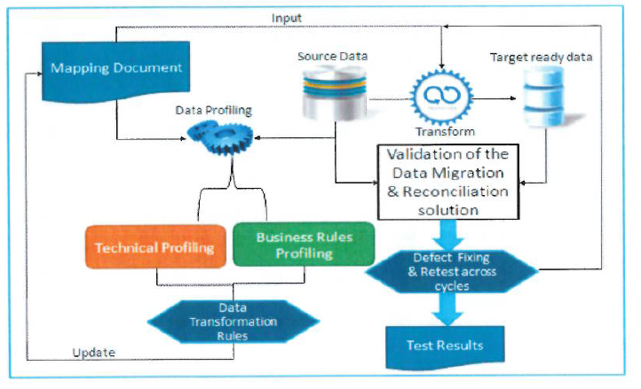



Data Quality and Validation Implementation @ Largest Bank in the MENA region
Solution Details
Recommendation on auto-correction rules based on industry experience to reduce cost and effort involved in manual cleansing
1700+ data quality issues are identified for 180+ data entities across 35+ applications
PLATINUM - Cognizant’s proprietary and licensed tool
Solution Architecture
Value adds/
Investments
Deviations in business and operational processes across banks causing data quality issues
Recommendation on Data Cleansing approach considering effort required to cleanse data in source application to be decommissioned versus transformation complexity during migration causing heavy migration sequence
Evolving migration specs, data mapping and change requests to align with target business process
Solution Description
Early detection of migration blockers by performing profiling on source data based on target mapping specs
Data from source systems in standard format is processed by ETL processes into the pre-target layer.
Data from pre-target area is uploaded into target applications
Downstream feed extract and reports are generated and published
Data Validation on each hops to avoid failure during target upload process and reduce effort and time involved in failure backups
Qualitative and Quantitative data reconciliation reports to validate the data migration success
Challenges Faced

Slide 3
Data Quality and Validation Implementation @ Largest Bank in the MENA region
Project Details
Project start and completion date/ Duration | July 2017, inflight project
Project Manager (Onsite/Offshore)/POCs | Shailesh Pratap Singh (Onsite)
Portfolio Director - needs to sign off on the case study | Soumya DasGupta (Offshore)
Peak team size | 25
Service line involved | BFS
COE involved | DQG COE, BISQUAD and CBC - BFS
Onsite/offshore Ratio | Complete Onsite
Location of the project | Abu Dhabi (UAE)
Key themes | One Bank Customer Experience
Any unique highlights of the project | Rule based cross application Data Profiling and Validation
Client LoBs/ BU involved | TIO (Technology integration office)

